Slide 1

Welcome to our lesson!
Now we’re going to repeat the numbers!
Let’s count!

Slide 2


Slide 3
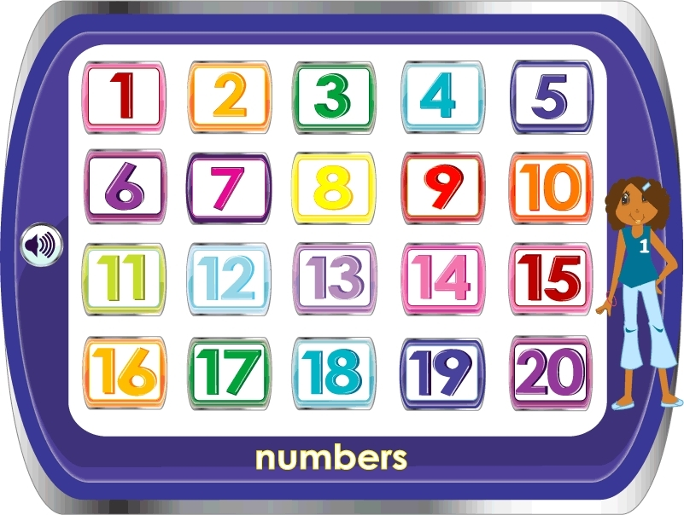
Let’s count!

Slide 4
eleven
twelve
fourteen
thirteen
fifteen

Slide 5
sixteen
seventeen
twenty
eighteen
nineteen

Slide 6
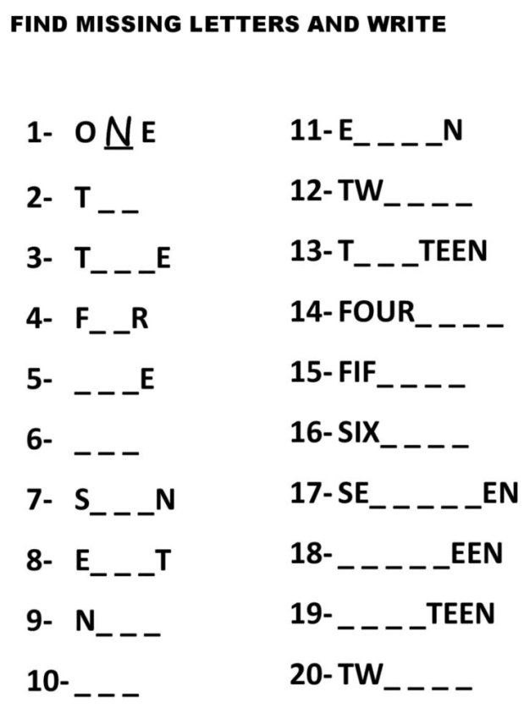

Slide 7
Now we’re going to repeat the ABC!
Let’s sing the song, please!

Slide 8
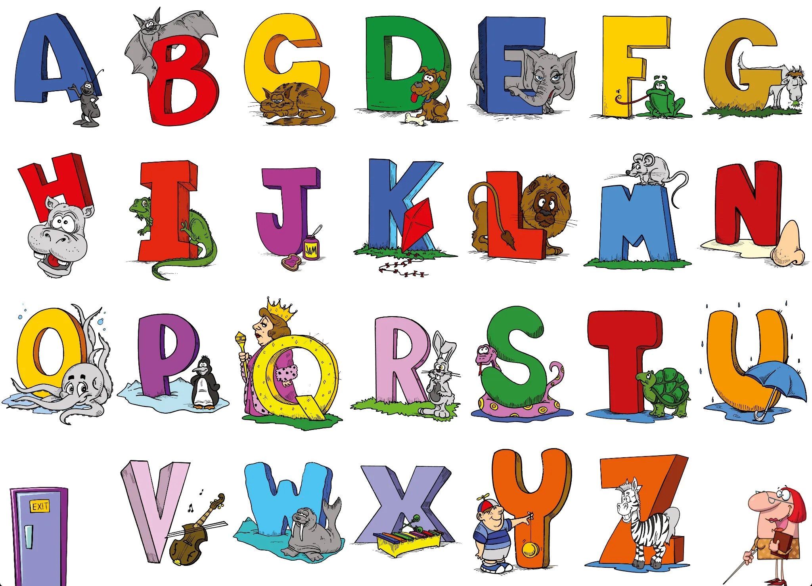

Slide 9
https://ya.ru/video/preview/9521426535961455700?text=abc%20song%20spotlight%205&path=yandex_search&parent-reqid=1793928454925087-3359947013594420152-cjvhzrx6gv72ejib-BAL&from_type=vast

Slide 10
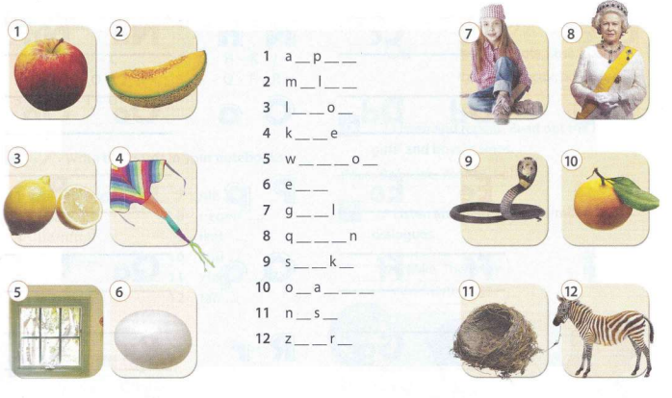

Slide 11


Thanks for the lesson

