Slide 1
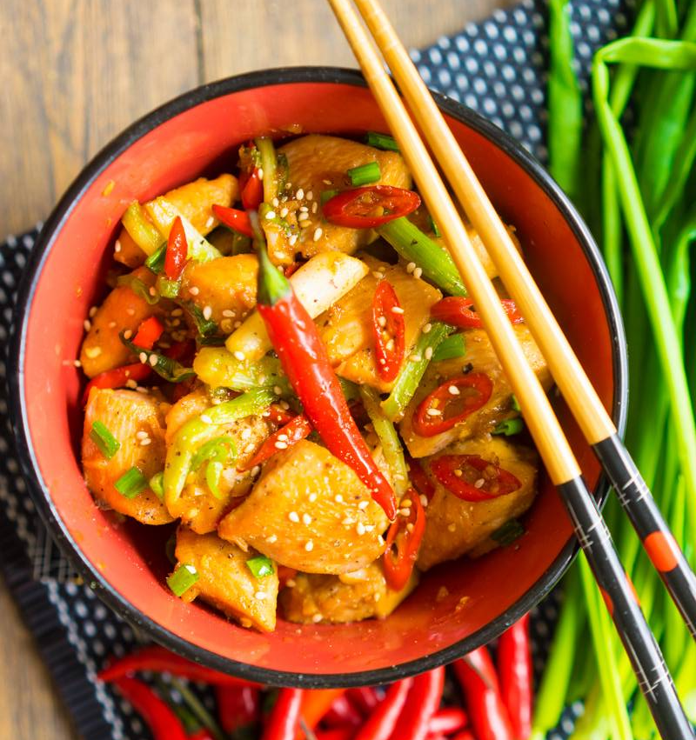
Chinese
food
Eastern cuisine
PRESENTATION BY: SLIDECORE

Slide 2
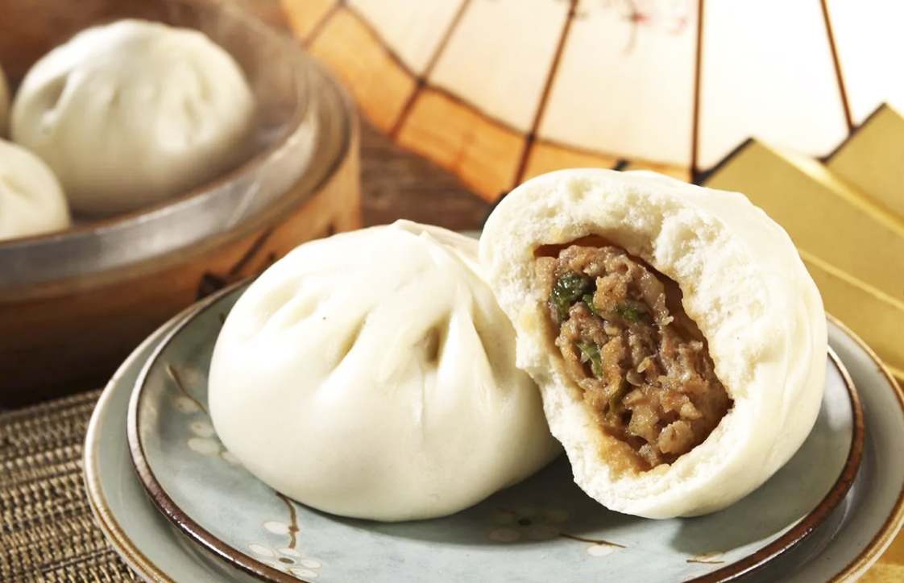
CHINESE FOOD
Chinese food is famous all over the world, but you may be shocked by its surprising range and variety of ingredients if you’ve only eaten in Chinese restaurants abroad. Chinese food has countless delicious and fantastic dishes. And people from different areas have different cuisine types, which can be bland, sweet, salty, spicy, or sour

Slide 3
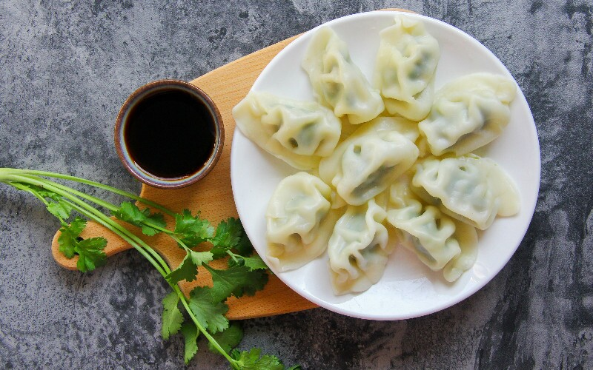
Northern China food
China can be divided into several regions with distinct styles of cooking. The ingredients used are based on the natural and agricultural products of each region.
Northern China food — salty, simple, less vegetables with wheat as the staple food. Food using wheat as its main ingredient, such as noodles and dumplings is prevalent there.
Northerners tend to eat more (red) meat and dairy, as the calories, fat, and protein strengthen their bodies against the chilly weather.

Slide 4
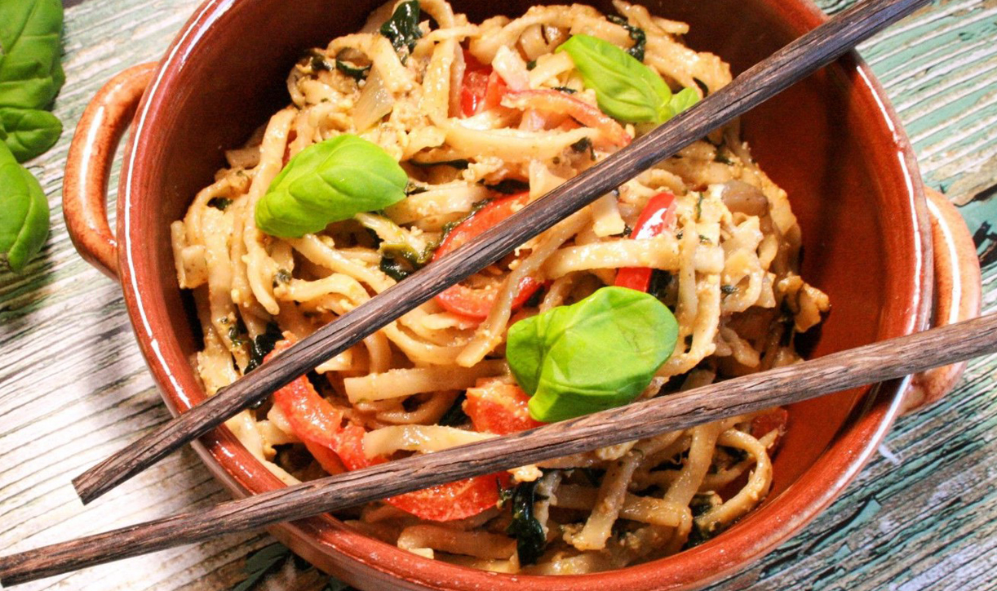
Western China food
Western China food — hearty halal food /сытная
There is no pork or carnivorous animals on the menu. Wheat is the main staple grain, and a few vegetables are grown there, mostly onions, carrots, peppers, eggplants, and tomatoes.

Slide 5
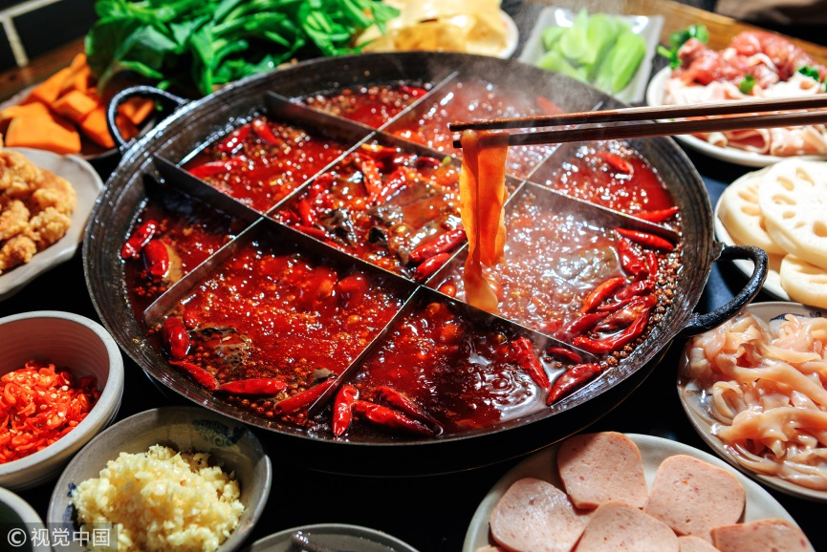
Central China food
Central China food— spicy with a lot of seasonings. It is characterized by lots of preserved foods, particularly pickled vegetables and tofu, which give it its sour flavor.
Sichuan hotpot

Slide 6
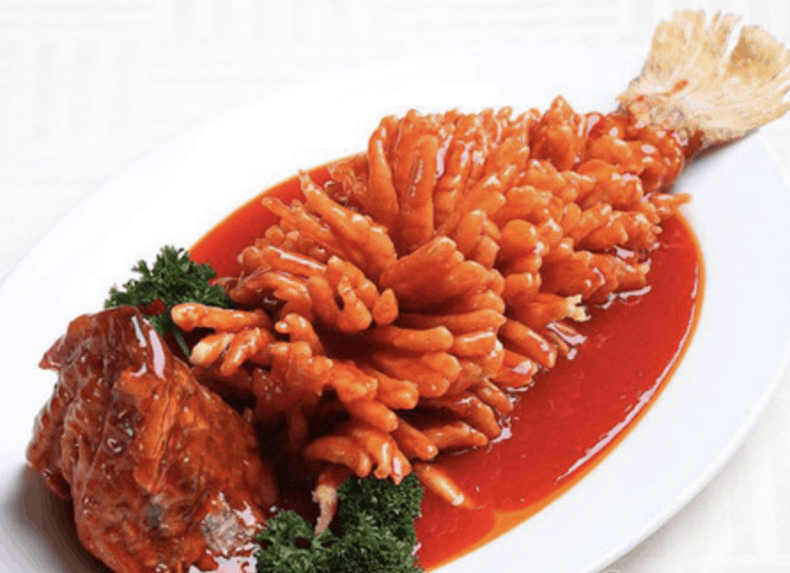
Eastern China food
Eastern China food — sweet and light. Eastern food features an abundant use of seafood, fish, pork, poultry, a wide variety of vegetables. Both rice and wheat are common staples.
Sweet and sour fish

Slide 7
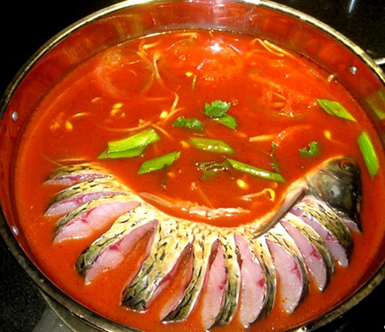
Southern food
Southern minority food — sour, and many minorities eat chilies every day.
Southern ethnic food is typically simple and full of natural ingredients, with little wastage. Heads, feet, and innards are all eaten.
Guizhou sour fish

Slide 8
Chinese Food 101: North vs. South vs. East vs. West
https://www.youtube.com/watch?v=oHCBgAcfVKE

Slide 9
Break
5 MIN

Slide 10
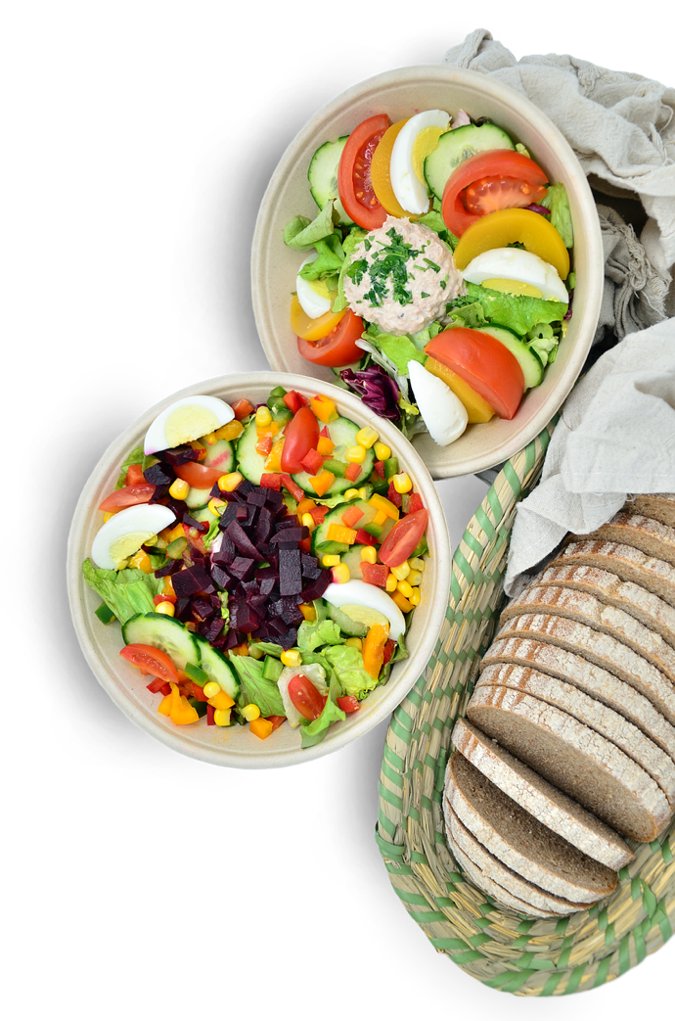
Exercises
1. Ответьте на вопросы:
Is the cuisine the same in different regions of China?
What are the features of Western Chinese food?
What are the features of Central China food?
What are the features of Eastern China food ?
What are the features of Southern minority food?

Slide 11
Exercises
2. Ниже даны группы определений. Следующие слова отнесите к подходящим группам определений: coffee, wine, drink, water, juice, milk, beer, tea
1. fruit, orange, pineapple, tomato ……… 2. semi-skimmed, full-cream ……… 3. mineral, still, fizzy, sparkling ……… 4. red, white, rose, dry, sweet, sparkling ……… 5. strong, low-alcohol, bottled, draught ……… 6. black, white, strong, real, instant ……… 7. strong, weak, herbal, green, mint ……… 8. non-alcoholic, soft, fizzy, strong ………

Slide 12
Exercises
3. Вставьте следующие слова в пропуски:malt, barley, distilleries, hops, peat, water
All over the world beer is brewed in breweries, usually from (1) ___ . Whisky, on the other hand, is mostly made in Scotland in (2) ___ . Whisky is a spirit made from (3) ___ . There are two kinds of Scotch – (4) ___ whisky and blended whisky. Some of the most famous distilleries are in the Scottish Highlands and Islands. Whisky varies in colour and taste. This depends on the (5) ___ used in the production process. Water which runs through (6) ___ gives the whisky a darker colour and a taste like smoke.

Slide 13
Exercises
Упражнение 4. Прочитайте историю, которая вполне могла случиться. Выберите правильный вариант глагола-действия.
I (met/was meeting) a friend while I (did/was doing) the shopping. While I (paid/was paying) for my things, I (heard/was hearing) someone call my name. I (turned/was turning) round and (saw/seeing) Paula. She (wore/was wearing) a bright red coat. We (decided/were deciding) to have a cup of coffee. While we (had/ were having) a drink, a waiter (dropped/was dropping) pile of plates. We all (got/were getting) a terrible shock. While the waiter (picked/was picking) up the broken plates, he (cut/was cutting) his finger. We (left/were leaving) the cafe and (said/were saying) goodbye. I (finished/was finishing) my shopping and (went/was going)

Slide 14
Exercises
5. Поставьте глаголы в скобках в правильную форму.
You … (not to listen) to the radio, you … (to read) the letter from your niece.
Clara … (to take) a bath at nine o’clock yesterday evening.
Monica and her friend … (to have) coffee in the sitting-room.
Our Granny … (not to plant) tomatoes in the garden.
Dick … (to carry) his bag towards the hotel room.
Sally and Frank … (not to decorate) the classroom, they … (to prepare) a wall newspaper.
The professor … (to give) a lecture but some students … (not to listen) to him.
The nurse … (not to take) his temperature, she … (to give) him an aspirin.
The train … (to arrive) at the station at seven o’clock.
Olga … (not to wait) for us yesterday evening.

Slide 15
Thanks
END

