Slide 1
The World of food

Slide 2
I eat apples -
crunch, crunch, crunch.
I eat sandwiches –
Munch, munch, munch.
I eat lollipops –
Lick, lick, lick.
But I eat ice-cream
Quick, quick, quick!

Slide 4
:

Slide 6
Fill in the gaps with much and many.
1. How………sandwiches would you like?
2. How………jam do you need?
3. How………tea do you drink for dinner?
4. How………eggs are there in the fridge ?
5. How………yoghurt have you got?

Slide 7
1. How…many……sandwiches would you like?
2. How…much……jam do you need?
3. How……much …tea do you drink for dinner?
4. How……many…eggs are there in the fridge ?
5. How…much……yoghurt have you got?

Slide 10
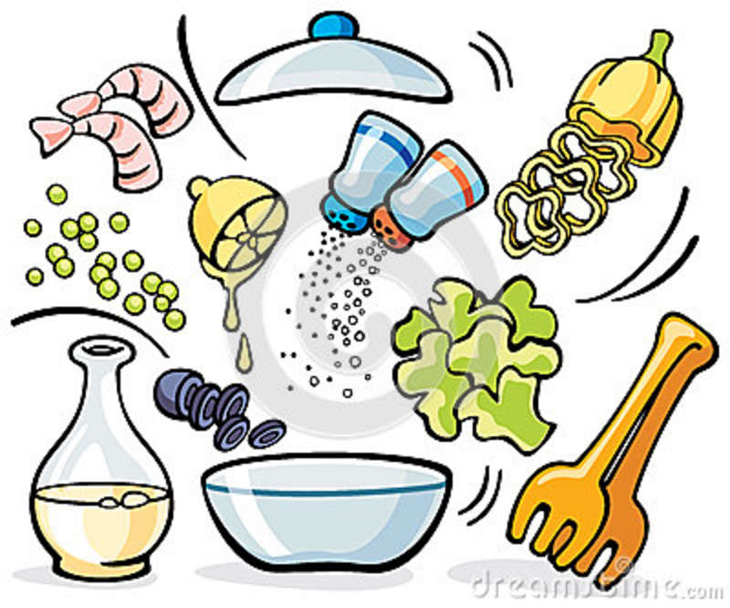
Let’s make a …

Slide 11
Excellent
Good
Bad

Slide 12
Your home task will be:
Be ready to tell the class about your favorite food .

Slide 13
Thank you !

